Slide 1



JSPM’s Bhivarabai Sawant Institute of Technology and Research,Wagholi,Pune-412207 Department of Computer Engineering UNIT I TREES
Presented By Prof. Anjali V. Almale

Slide 2
Institute & Department Vision Mission
Institute Vision :
"Satisfy the aspirations of youth force, who want to lead nation towards prosperity through techno-economic development."
Institute Mission :
“To provide, nurture and maintain an environment of high academics excellence, research and entrepreneurship for all aspiring students, which will prepare them to face global challenges maintaining high ethical and moral standards.“
Departmental Vision :
“Empowering the students to be professionally competent & socially responsible for techno- economic development of society.”
Departmental Mission :
A: To provide quality education enabling students for higher studies, research and entrepreneurship
B: To inculcate professionalism and ethical values through day to day practices.

Slide 3
Objectives
Study how trees are used to represent data in hierarchical manner
Define Binary Search Trees (BST), that allow both rapid retrieval by key and inorder traversal
Learn use of trees as a flexible data structure for solving a wide range of problems

Slide 4
Introduction
Tree, a non-linear data structure, is a mean to maintain and manipulate data in many applications

Slide 5
Trees
A class of graphs which that are acyclic are termed as trees
Trees are useful in describing any structure which that involves hierarchy
Familiar examples of such structures are family trees, the hierarchy of positions in organization, etc

Slide 6

Forest and Trees
In non-linear data structures, every data element may have more than one predecessor as well as successor
Elements do not form any particular linear sequence
A forest is a graph that contains no cycles and a connected forest is a tree
Figure 6: Forest with three trees

Slide 7
Directed Tree : An acyclic directed graph is a directed tree
Root : A directed tree has one node called its root, with indegree 0, while for all other nodes in-degree is 1

Slide 8
Terminal node (Leaf node) : In a directed tree, any node which has out degree zero is a terminal node
Terminal node is also called as leaf node (or external node)
Branch node (Internal node) : All other nodes whose outdegree is not zero are called as branch nodes
Level of node : The level of any node is the path length of it from the root.
The level of root of a directed tree is 0, while the level of any node is equal to its distance from the root
Distance from the root is the number of edges to be traversed to reach the root

Slide 9
General Trees
A tree is defined recursively, as follows
A set of zero items is a tree, called the empty tree (or null tree)
If T1, T2, - - - -,Tn are n trees for n > 0 and R is an item, called a node, then the set T containing R and the trees T1, T2, - - - - ,Tn is a tree
Within T, R is called the root of T and T1, T2, - - - -, Tn are called subtrees

Slide 10

Representation of a General Tree
We can use either sequential organization or linked organization for representing a tree
If we wish to use generalized linked list, then a node must have varying number of fields depending upon the number of branches
However, it is simpler to use algorithms for data in which the node size is fixed
Figure 6: Node Structure

Slide 11
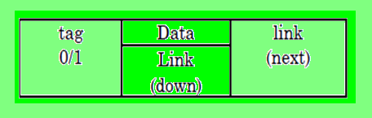
Pseudo code Notations
For a fixed size node, we can use a node with data and pointer fields as in generalized linked list
Figure 7: Node Structure in generalized linked list

Slide 12
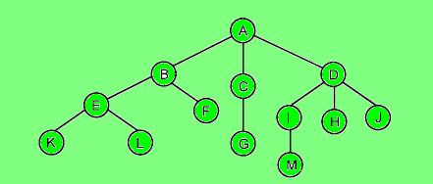
Sample Tree
Sequence
Decision-Tree
Repetition
Figure 8: Sample Tree

Slide 13
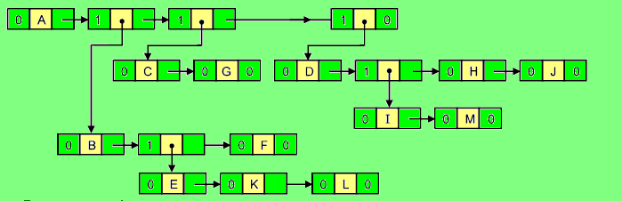
Figure 9: List Representation of Tree in Figure 8
Figure 9: List Representation of Tree in Figure 8

Slide 14
Types of Tree
Free tree
Rooted tree
Ordered tree
Position tree
Complete tree
Regular tree
Binary tree

Slide 15
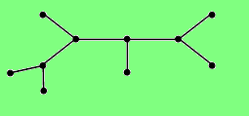
Specification
A free tree is a connected, acyclic graph
It is undirected graph
It has no node designated as a root
As it is connected, any node can be reached from any other node by a unique path
Free Tree
Figure 10: Free Tree

Slide 16
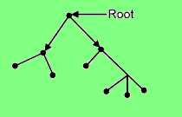
Unlike free tree, rooted tree is a directed graph in which one node is designated as root, whose incoming degree is zero
And for all other nodes incoming degree is one
Rooted Tree
Figure 11: Rooted Tree

Slide 17
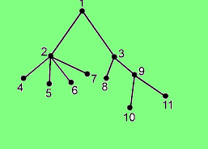
In many applications the relative order of the nodes at any particular level assumes some significance
It is easy to impose an order on the nodes at a level by referring to a particular node as the first node, to another node as the second, and so on
Such ordering can be done left to right
Ordered Tree
Figure 12: Ordered Tree

Slide 18
A tree in which each branch node vertex has the same out-degree is called as Regular Tree
If in a directed tree, the outdegree of every node is less than or equal to m, then the tree is called as an m-ary tree
If the outdegree of every node is exactly equal to m (branch nodes) or zero (leaf nodes) then the tree is called as regular m-ary tree
Regular Tree

Slide 19
A Binary Tree is a special form of a tree
A tree in which each branch node vertex has the same out-de Binary tree is important and frequently used in various applications of computer science
Binary Tree

Slide 20
A tree with n nodes and of depth k is complete iff its nodes correspond to the nodes which are numbered one to n in the full tree of depth k
A binary tree of height, h, is complete iff it is empty or
its left subtree is complete of height h – 1 and its right subtree is completely full f height h – 2 or – its left subtree is completely full of height h-1 and its right subtree is complete of height h – 1
A binary tree is completely full if it is of height, h and has (2h+1 – 1) nodes
Complete Tree

Slide 21
A binary tree is a full binary tree, if it contains maximum possible number of nodes in all levels
In a full binary tree each node has two children or no child at all
Total number of nodes in full binary tree of height h is 2h+1 – 1 considering root at level 0.
It can be calculated as by adding number of nodes of each level 2 0 + 2 1 + 2 2 + ………..+ 2 h = 2 h+1 – 1
Full Binary Tree

Slide 22
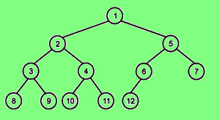
A binary tree is said to be a complete binary tree, if all its level, except the last level, have maximum number of possible nodes, and all the nodes of the last level appear as far left as possible
In a complete binary tree all leaf nodes are at last and second last level and levels are filled from left to right
Complete Binary Tree
Figure 13: Complete Binary Tree

Slide 23
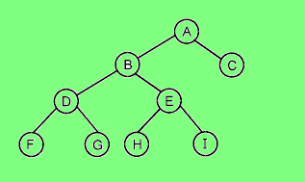
Every non-terminal node in a binary tree consists of non-empty left subtree & right subtree, then such a tree is called Strictly Binary Tree
Strictly Binary Tree
Figure 15: Strictly Binary Tree

Slide 24
A binary tree T consists of each node has 0 or 2 children is called extended binary tree
Node with 2 children are called internal nodes and nodes with 0 children are called external nodes
Trees can be converted into extended trees by adding a node
Binary Tree(cont….)

Slide 25
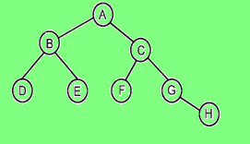
Definition : A Binary Tree is either :
an empty tree; or
consists of a node, called root and two children, left and right, each of which are themselves binary trees
Binary Tree(cont….)
Figure 16 : Binary Tree

Slide 26
Binary Tree(cont….)
1. Declare CREATE( ) btree
2. MAKEBTREE(btree,element, btree) btree
3. ISEMPTY(btree) boolean
4. LEFTCHILD(btree) btree
5. RIGHTCHILD(btree) btree
6. DATA((btree) element
for all l,r ε btree, e ε element, Let
7. DATA(MAKEBTREE(l,e,r)) = e
8. ISEMPTY(CREATE) = true
9. ISEMPTY(MAKEBTREE(l,e,r)) = false
10. LEFTCHILD(CREATE( )) = error
11. RIGHTCHILD(CREATE( )) = error
12. LEFTCHILD(MAKEBTREE(l,e,r)) = l
13. RIGHTCHILD(MAKEBTREE(l,e,r)) = r
15. end

Slide 27
Operations on Binary Tree
The basic operations on a binary tree can be as listed below as follows:
Creation : Creating an empty binary tree to which 'root' points
Traversal : To Visiting all the nodes in a binary tree
Deletion : To Deleting a node from a non-empty binary tree A binary tree T consists of each node has 0 or 2 children is called extended binary tree
Insertion : To Inserting a node into an existing (may be empty) binary tree

Slide 28
Operations on Binary Tree
The basic operations on a binary tree can be as listed below as follows:
Merge : To Merging two binary trees
Copy : Copying a binary tree
Compare : Comparing two binary trees
Find replica or mirror

Slide 29
Realization Of A Binary Tree
The two main reasons are
A Binary Tree has a natural implementation in linked storage
The linked structure is more convenient for insertions and deletions

Slide 30
Array Implementation of a Binary Tree
For any node with index i, 0 ≤ i ≤ n-1,
PARENT (i) = ë(t–1)/2û if i ¹ 0
If i = 0
then it is root which has no parent
LCH ILD (i) = 2 * i + 1 if 2i + 1 ≤ n-1
If 2i ³ n,
then i has no left child
RCHILD (i) = 2i + 2 if 2i + 2 ≤ n-1
If (2i + 1) ³ n,
then i has no right child

Slide 31
Advantages of Array Representation of Binary Tree
Any node can be accessed from any other node by calculating the index
Here, data are stored without any pointers to their successor or ancestor
Programming languages, where dynamic memory allocation is not possible (such as BASIC, FORTRAN), array representation is the only mean to store a tree

Slide 32
Disadvantages of Array Representation of Binary Tree
Other than full binary trees, majority of the array entries may be empty
Other than full binary trees, majority of the array entries may be empty
a new node to it or deleting a node from it are inefficient with this representation, because these require considerable data, movement up and down the array which demand excessive Inserting amount of processing time

Slide 33
Binary tree has natural implementation in linked storage. In linked organization we wish that all nodes should be allocated dynamically
Hence we need each node with data and link fields
Each node of a binary tree has both a left and a right subtree
Linked Implementation of Binary Trees

Slide 34

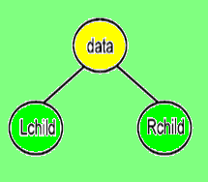
Linked Implementation of Binary Trees
Each node will have three fields Lchild, Data, and Rchild. Pictorially this node is shown in Fig.
Figure 17 : Node Structure in Binary Tree

Slide 35
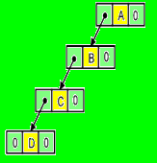
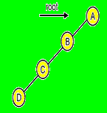
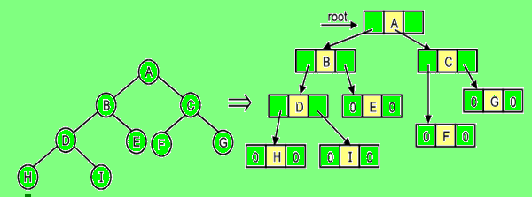
Figure ‘a’
Figure ‘b’
Figure 18 : Linked Representation for Binary Tree

Slide 36
Advantages of Linked Representation of Binary Tree
The drawback of sequential representation are overcome in this representation
We may or may not know the tree depth in advance. Also for unbalanced tree, memory is not wasted
Insertion and deletion operations are more efficient in this representation.

Slide 37
Disadvantages of Linked Representation of Binary Tree
In this representation, there is no direct access to any node
It has to be traversed from root to reach to a particular node
As compared to sequential representation memory needed per node is more
This is due to two link fields (left child and right child for binary trees) in node
The drawback of sequential representation are overcome in this representation

Slide 38
This operation is used to visit each node (or visit each node exactly once)
A full traversal of a tree visits nodes of a tree in a certain linear order
This linear order could be familiar and useful
For example, if the Binary Tree contains an arithmetic expression then its traversal may give us the expression in infix notation or postfix notation or prefix notation

Slide 39
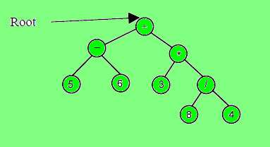
Figure 19: A Binary Tree Representing an Arithmetic Expression

Slide 40
Computing Time Complexity of Algorithm
LDR : 5 – 6 + 3 * 8 / 4
LRD : 5 6 – 3 8 4 / * +
DLR : + – 5 6 * 3 / 8 4
DRL : + * / 4 8 3 – 6 5
RDL : 4 / 8 * 3 + 6 – 5
RLD : 4 8 / 3 * 6 5 – +

Slide 41
In this traversal, the root is visited first then left subtree in preorder and then right subtree in preorder
Tree characteristics lead to naturally implement tree traversals recursively
It can be defined in the following steps.
Preorder (DLR) Algorithm:
Visit the root node
Traverse the left subtree of node in preorder and then
Traverse the right subtree of node in preorder
Pre-order Traversal

Slide 42
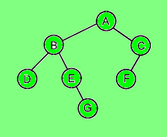
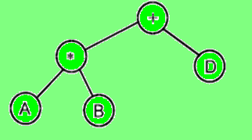

Pre-order Traversal
A preorder traversal of the tree in Fig. 2 visits node in a sequence: A B D E G C F
For an Expression Tree, preorder traversal yields a prefix expression
Figure 20: Binary Tree
Figure 21: Expression Tree and its preorder traversal

Slide 43
In-order Traversal
In this traversal, the left subtree is visited first in inorder, then root and then the right subtree in inorder

Slide 44
In-order Traversal
Inorder ((LDR)) Algorithm
(a) Traverse the left subtree of root node in inorder
(b) Visit the root node
(c) Traverse the right subtree of root node in inorder

Slide 45
In-order Traversal
Inorder traversal is also called as symmetric traversal

Slide 46
Post-order Traversal
In this traversal, the left subtree is visited first in postorder, then the right subtree in postorder and then the root

Slide 47
Post-order Traversal Algorithm
(i) Traverse the root's left child (subtree) of root node in postorder
(ii) Traverse the root's right child (subtree) of root node in postorder
(iii) Visit the root node

Slide 48
For the expression tree in Fig. 21 the postorder traversal yields a postfix expression as : = A B * D +
The postorder traversal says that traverse left and continue again
When you cannot continue, move right and begin again or move back, until you can move right and visit the node
Pre-order Traversal

Slide 49
Non-recursive Implementations of Traversals

Slide 50
Sometimes we need to construct a binary tree if its traversals are known
From a single traversal a unique binary tree cannot be constructed
However, if two traversals are known then the corresponding tree can be drawn uniquely
Formation of Binary Tree from its Traversals

Slide 51
If the preorder traversal is given, then the first node is the root node
If the preorder traversal is given, then the first node is the root node
Once the root node is identified, all the nodes in all left subtrees and right subtrees of the root node can be identified
Same techniques can be applied repeatedly to form subtrees
We can conclude that, for the binary tree construction and traversals are essential out of which one should be inorder traversal and another preorder or postorder
Alternatively given preorder and postorder traversals, binary tree cannot be obtained uniquely
Formation of Binary Tree from its Traversals

Slide 52
As defined earlier, we know that traversal of tree means visiting through the nodes of a tree
A traversal in which the node is visited before its children are visited is called a breadth first traversal; a walk where the children are visited prior to the parent is called a depth first traversal
Breadth and Depth First Traversals

Slide 53
Depth-first Traversal
We have already seen a few ways to traverse the elements of a tree
A traversal in which children are visited (operated on) before the parent is called Depth First Traversal

Slide 54
For Example, given the following tree
A Preorder Traversal would visit the elements in the order
j, f, a, d, h, k, h
This type of traversal is called a Depth-first Traversal
Because as it tries to go deeper in the tree before exploring siblings
Depth-first Traversal

Slide 55
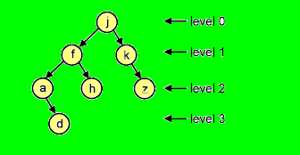
For Depth-first is not the only way to go through the elements of a tree
Another way is to go through them level-by-level
For example, each element exists at a certain level (or depth) in the tree
Breadth-first Traversal

Slide 56
This operation computes the height of linked binary tree. Height of tree is maximum path length in tree
We can get path length by traversing tree depth wise
Let us consider that an empty tree's height is 0 and tree with only one node has height
Computing Height of Binary Tree

Slide 57
This operation finds mirror of the tree that will interchange all left and right subtrees in linked binary tree
Getting mirror or replica or Tree Interchange of Binary Tree

Slide 58
TreeCopy operation will make a copy of linked binary tree
The function should allocate necessary nodes and copy respective contents in it. as right child
Copying Binary Tree

Slide 59
This operation checks whether two binary trees are equal
Two trees are said to be equal if they have the same topology and all corresponding nodes are equal
Same topology refers to fact that each branch in first tree corresponds to a branch in second tree in the same order and vice versa
Equality Test

Slide 60
Conversion Of A General Tree To Binary Tree
Binary trees are trees where the maximum degree of any node is two
Any general tree can be represented as a binary tree using the following algorithm
ALL nodes general tree will be nodes of binary tree.
The root T of general tree is the root of binary tree.
To obtain a binary tree, we use a relationship between the nodes that can be characterized by two characteristics
i) One relationship is the leftmost-child

Slide 61
A Binary Search Tree (BST) is a binary tree that is either empty or in which every node contains a key and satisfies the conditions:
The key in the left child of a node, if it exists, is less than the key in its parent node
The key in the right child of a node, if it exists, is greater than the key in its parent node
The left and right subtrees of node are again binary search trees
The definition ensures that no two entries in a binary search tree can have equal keys
Binary Search Tree (BST)

Slide 62
Following are the operations commonly performed on binary search tree
Searching a key
Inserting a key
Deleting a key
Traversing a tree
Equality Test

Slide 63
Thornton has suggested to replace all the null links by pointers, called Threads
A tree with thread is called as Threaded Binary Tree (TBT)
Both threads and tree pointers are pointers to nodes in the tree
The difference is that threads are not structural pointers of the tree
They can be removed and the tree does not change
Tree pointers are the pointers that join and hold the tree together
Threaded Binary Tree

Slide 64
Threads utilize the NULL pointers waste space to improve processing efficiency
One such application is to use these NULL pointers to make traversals faster
In a left NULL pointer, we store a pointer to the node's inorder successor
This allows us to traverse the tree both left to right and right to left without recursion
Threaded Binary Tree

Slide 65
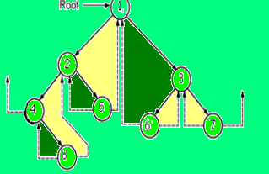
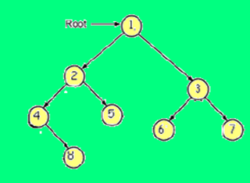
Threaded Binary Tree
Figure 23: Threaded binary Tree

Slide 66
Pros and Cons of Threaded Binary Tree
Threaded binary tree has some advantages over non-threaded binary tree.
The traversal for threaded binary tree is straight forward. No recursion or stack is needed
Once we locate the leftmost node, we loop, following the thread to next node
When we find null thread, the traversal is complete

Slide 67
Pros and Cons of Threaded Binary Tree
In case of non threaded binary tree, this task is time consuming and difficult
Also stack is needed for the same Threaded binary tree has some advantages over non-threaded binary tree.
Threads are usually more to upward whereas links are downward
Thus in a threaded tree we can traverse in either direction and nodes are infact circularity linked
Hence, any node can be reached from any other node
Insertions into and deletion from a threaded tree are although time consuming as the link and thread are to be man

Slide 68
Applications Of Binary Trees
Gaming
Expression
Huffman Code And
Decision Trees

Slide 69
Expression
Binary tree storing or representing an arithmetic expression is called as expression tree
The leaves of an expression tree are operands
Operands could be variables or constants
Branch nodes (internal nodes) represent the operators
Binary tree is the most suitable one for arithmetic expression as it contains either binary or unary operators

Slide 70
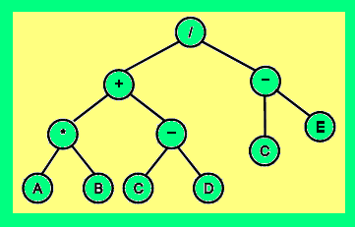
Expression
The expression tree for expression E, is shown in Fig.
Let E : ((A * B)+ (C – D)) / (C – E)
Figure 25: Expression Tree for E= ((A * B) + (C – D)) / (C – E)

Slide 71
DECISION TREE
Decision Tree is a classifier in the form of a tree structure , where each node is either
A Leaf Node - indicates the value of the target attribute (class) of examples, or
A Decision Node - specifies some test to be carried out on a single attribute-value, with one branch and sub-tree for each possible outcome of the test
A Decision Tree can be used to classify an example by starting at the root of the tree and moving through it until a leaf node, which provides the classification of the instance
Decision Tree induction is a typical inductive approach to learn knowledge on classification

Slide 72
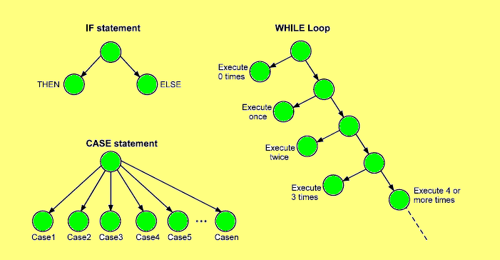
Decision Tree
Figure 26 : Decision Tree

Slide 73
Weaknesses Of Decision Tree
Decision Trees are less appropriate for estimation tasks where the goal is to predict the value of a continuous attribute
Decision Trees are prone to errors in classification problems with many class and relatively small number of training examples
Decision Tree can be computationally expensive to train
The process of growing a Decision Tree is computationally expensive

Slide 74
Weaknesses Of Decision Tree
At each node, each candidate splitting field must be sorted before its best split can be found. In some algorithms, combinations of fields are used and a search must be made for optimal combining weights
Decision Trees are less appropriate for estimation tasks where the goal is to predict the value of a continuous attribute
Decision trees do not treat well non-rectangular regions. Most decision-tree algorithms only examine a single field at a time
Decision Trees are prone to errors in classification problems with many class and relatively small number of training examples

Slide 75
HUFFMAN’S CODING
One of the most important applications of binary tree is in Communication
Huffman’s Algorithm :
1. Organize the data into a row as ascending order frequency weights. Each character is leaf node of a tree.
2. Find two nodes with the smallest combined weights and join them to form third node
3. This will form a new two level tree
4. The weight of new third node is addition of two nodes.
5. Repeat step 2 till all the nodes on every level are combined to form a single tree.

Slide 76
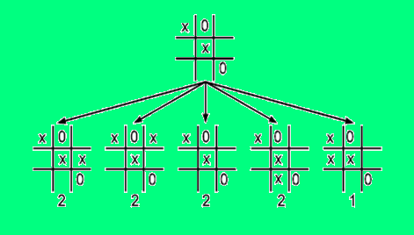
Game Trees
One of the most important applications of binary tree is in Communication
One of the most important applications of binary tree
Another Interesting application of trees is in the playing of games such as tic-tac-toe, chess, nim, checkers, go, etc
As an example let us consider the game of tic-tac-toe
Figure 27 : An example game tree

Slide 77
Summary
A binary tree is a special form of a tree. Binary tree is important and frequently used in various application of computer science. A binary tree has degree two, each node has at most two children. This makes the implementation of tree easier. Implementation of binary tree should represent hierarchical relationship between parent node and its left and right children.
Tree, a non-linear data structure, is a mean to maintain and manipulate data in many applications as listed above. Where ever the hierarchical relationship among data is to be preserved, tree is used.
A binary tree is a special form of a tree. Binary tree is important and frequently used in various application of computer science. A binary tree has degree two, each node has at most two children. This makes the implementation of tree easier. Implementation of binary tree should represent hierarchical relationship between parent node and its left and right children.

Slide 78
Summary
Binary tree has natural implementation in linked storage. In linked organization we wish that all nodes should be allocated dynamically. Hence we need each node with data and link fields. Each node of a binary tree has both a left and a right subtree. Each node will have three fields Lchild, Data and Rchild.
The operations on binary tree include- insert node, delete node and traverse tree. Traversal is one of the key operations. Traversal means visiting every node of a binary tree. There are various traversal methods. For a systematic traversal, it is better to visit each node (starting from root) and its both subtrees in same way.

Slide 79
Summary
Let L represent left subtree, R represent right subtree and D be node data, three traversals are fundamental: LDR, LRD and DLR. These are called as inorder, postorder and preorder traversals because there is a natural correspondence between these traversals and producing the infix, postfix and preorder forms of an arithmetic expressions respectively. Also a traversal in which the node is visited before its children are visited is called a breadth first traversal; a walk where the children are visited prior to the parent is called a depth first traversal.
The binary search tree is a binary tree with the property that the value in a node is greater than any value in a node's left subtree and less than any value in the node's right subtree. This property guarantees fast search time provided the tree is relatively balanced.·
The key applications of tree include: expression tree, gaming, Huffman coding and decision tree.

Slide 80
End
of
UNIT 1….!

